Slide 1
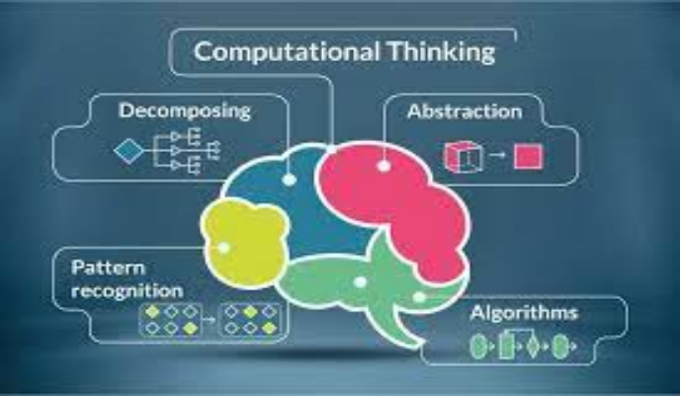
Unit 9.1 - Computational Thinking
Prepared by: Koh Kian Hua

Slide 2
Objectives
After completing this unit, students should be able to:
Understand the need for and benefits of using abstraction.
Describe the purpose of abstraction, and produce an abstract model of a system by only including essential details
.
Describe and use decomposition by breaking down problems into sub-problems leading to the concept of a program module (procedure / function)

Slide 3
Computational Thinking
Introduction
Computational thinking is used to study a problem and formulate an effective solution that can be provided using a computer.
Common techniques used in computational thinking, including abstraction, decomposition, algorithms and pattern recognition.
Practice is essential to develop skills in computational thinking.

Slide 4
Computational Thinking
Abstraction
Abstraction enables computer scientists to develop clear models for the solution to complex problems.
It involves extracting information that is essential while ignoring what is not relevant, and only including what is necessary to solve that problem.
Abstraction encourages the development of simplified models that are suited to a specific purpose by eliminating any unnecessary characteristics from that model.
Many everyday items use abstraction, such as maps, calendars and timetables.

Slide 5
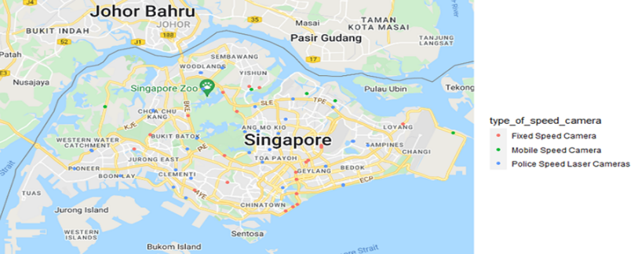
Computational Thinking
Abstraction
Maps use abstraction to show what is required for a specific purpose.
For example, a road map should only show the necessary detail required to drive from one place to another.
The road map in the figure below has reduced the complexity by only showing the essential details needed (eg:roads and towns), and removing other information about the terrain that are not be helpful.

Slide 6
Computational Thinking
Abstraction
The benefits of eliminating any unnecessary characteristics from the model include:
  Time required to develop the program is reduced so the program can be delivered to the customer more quickly.
  Program is smaller in size so takes up less space in memory and download times are shortened.
  Customer satisfaction is greater as their requirements are met without any extraneous features.

Slide 7
Computational Thinking
Why is Abstraction Important ?
Abstraction allows us to create a general idea of what the problem is and how to solve it.
The process instructs us to remove all specific detail, and any patterns that will not help us solve our problem.
This helps us form our idea of the problem and this idea is known as a ‘model’.
If we don’t abstract we may end up with the wrong solution to the problem we are trying to solve.
Abstraction can helped us to form a clearer understanding of the problem.

Slide 8
Computational Thinking
Stages of Abstraction
The first stage of abstraction is to identify the purpose of the model of the situation that is to be built.
  The situation could be one that occurs in real life, an imaginary one, or a future event.
  Once the purpose has been identified, sources of information need to be identified (eg: through observations and views of users etc).
The second stage is to use the information gathered from appropriate sources to identify what details are need in the model, and what details are unnecessary and need to be removed.
  eg: maps are used for many different purposes and can take different forms depending on the identified use.

Slide 9
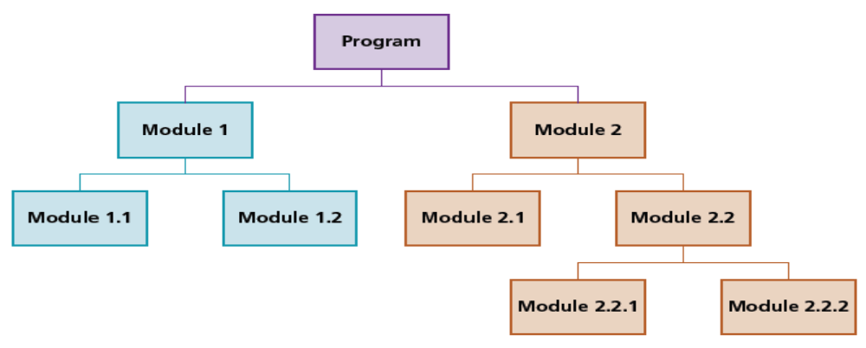
Computational Thinking
Decomposition
Decomposition is also an essential part of computational thinking.
It enables computer scientists to break a complex problem into smaller parts until each part is easy to examine and understand.
When a rigorous decomposition is undertaken, many simple problems are found to be more complex than initially thought.
Decomposition of a Program into Modules

Slide 10
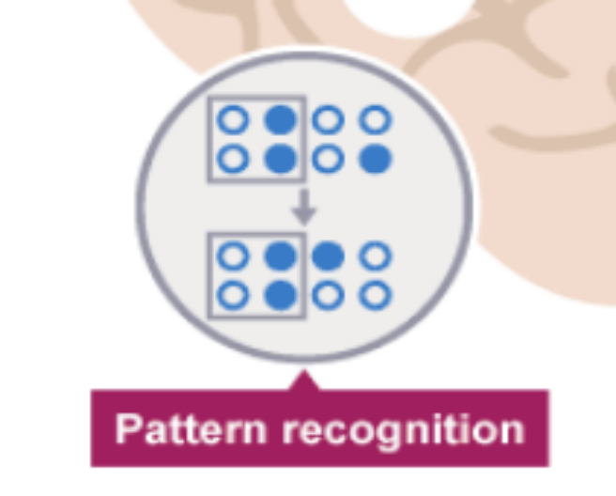
Computational Thinking
Pattern Recognition
Pattern recognition is all about recognizing patterns and connections among the different pieces of the larger problem.
These patterns can be both shared similarities and shared differences.
Pattern recognition is essential to building understanding from dense information and data.

Slide 11
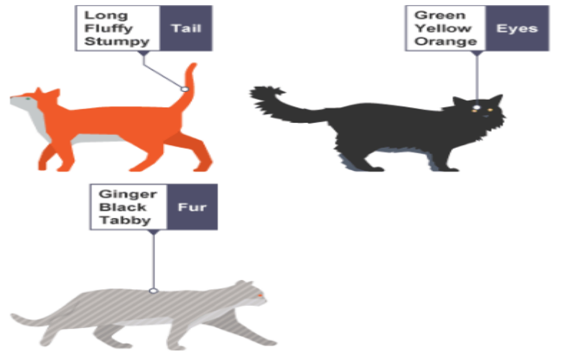
Computational Thinking
Pattern Recognition
Imagine that we want to draw a series of cats.
All cats share common characteristics. Among other things they all have eyes, tails and fur.
Because we know that all cats have eyes, tails and fur, we can make a good attempt at drawing a cat, simply by including these common characteristics.
  one cat may have green eyes, a long tail and black fur
  another cat may have yellow eyes, a short tail and striped fur

Slide 12
Computational Thinking
Why is Pattern Recognition Important
Finding patterns is extremely important because patterns make our task simpler.
Problems are easier to solve when they share patterns, because we can use the same problem-solving solution wherever the pattern exists.
The more patterns we can find, the easier and quicker our overall task of problem solving will be.

Slide 13
Computational Thinking
Examples of Pattern Recognition in Everyday Life
Epidemiology: Scientists identify the cause of a disease outbreak by looking for similarities in the different cases to determine the source of the outbreak.
Mathematics: Students recognize the specific formulas used to calculate slopes (gradients) and intercepts.
Science: Students classify animals based on their characteristics and articulate common characteristics for the groupings.
Languages: Students group different words in a foreign language by looking at their roots to build a better understanding of vocabulary.

Slide 14
Computational Thinking
Class Activity
1) Several techniques are used in computational thinking.
Explain what is meant by
a) Abstraction
b) Decomposition
c) Pattern Recognition.

